Slide 1

Designing Event Driven Microservices
With Apache Kafka and Spring Boot
Presented by - Saikiran Kondru (Senior Software Engineer)
JUNE 06 2023

Slide 2
Contents
01
What is Event Driven Architecture ?
02
What is Kafka ?
03
Core Concepts of Apache Kafka
04
Architecture using Kafka
05
Practical Use Case using Spring boot
06
Questions ?

Slide 3
01
Event Driven Architecture
Let us understand what does it mean to work with an event driven architecture

Slide 4
What is Event Driven Architecture
Event Driven Architecture
Event-driven architecture (EDA) is a software design pattern in which decoupled applications can asynchronously publish and subscribe to events via an event broker/message broker.
In an Event-Driven Architecture, applications communicate with each other by sending and/or receiving events or messages
Event-driven architecture is often referred to as “asynchronous” communication.
Event-driven apps can be created in any programming language because event- driven is a programming approach, not a language.

Slide 5



Event-Driven in Action
Getting data to where it’s needed, before it is used
Respond to events before the moment passes
Responsive & personalised customer experiences
Bring real time intelligence to your apps

Slide 6

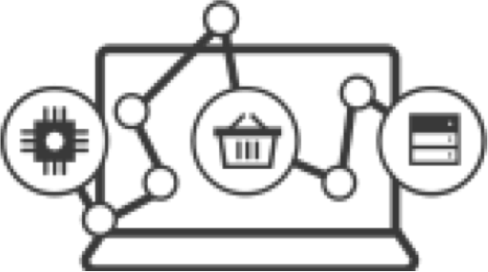




Components of an event-streaming application
4
App
3
Event Backbone
1
Building Blocks
:: Event Sources
:: Stream Processing
:: Event Archive
:: Notifications
2
App

Slide 7
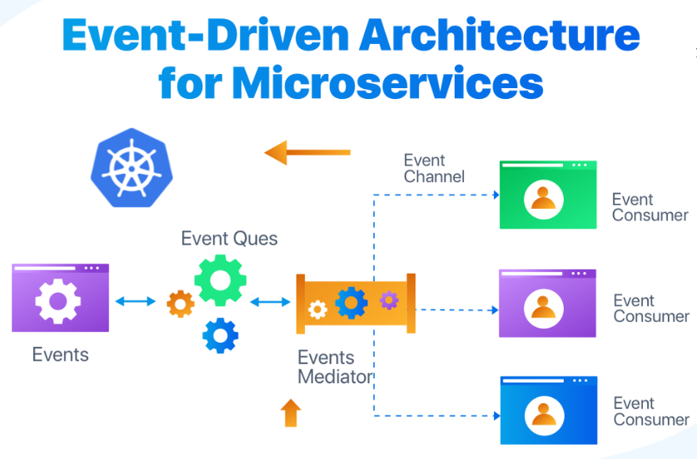

Slide 8
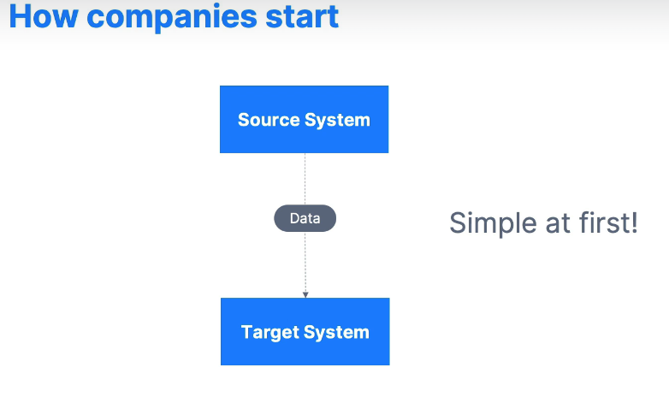

Slide 9
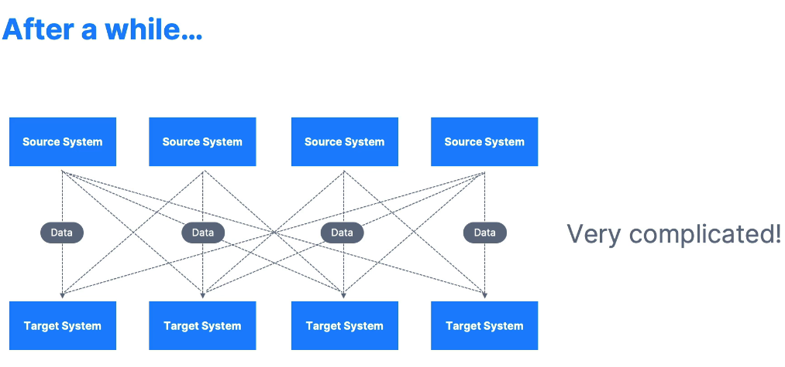

Slide 10
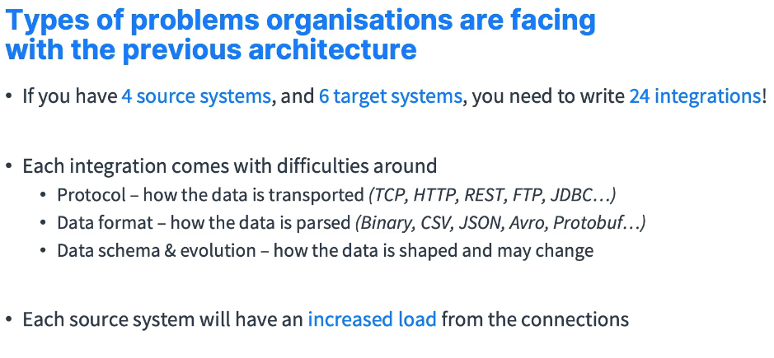

Slide 11
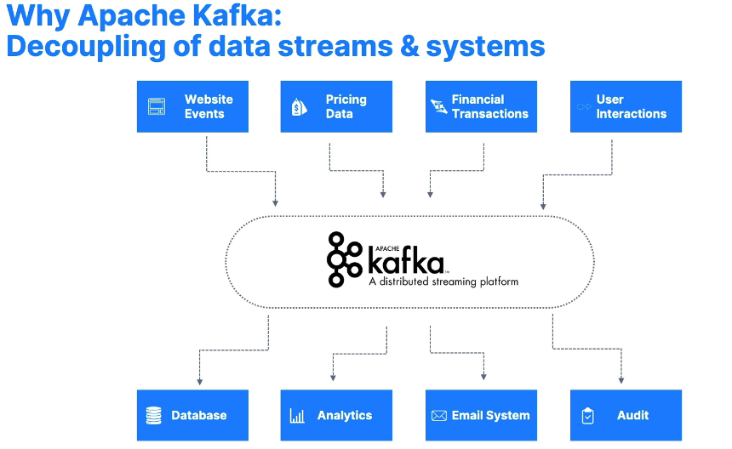

Slide 12
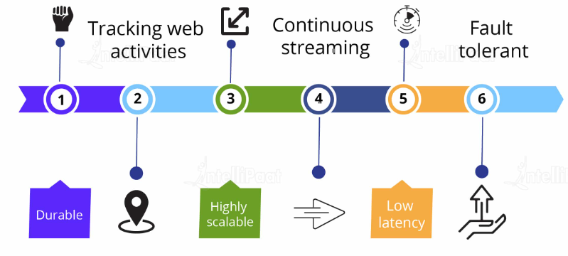
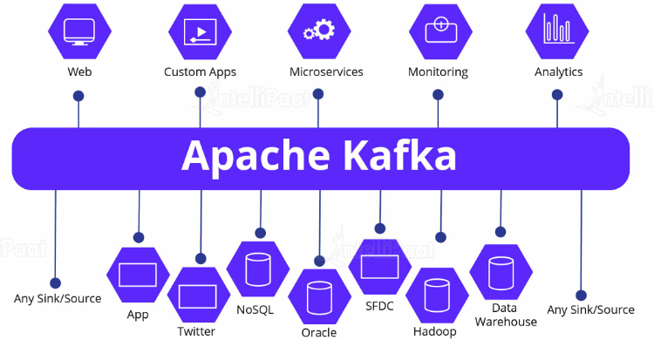
Advantages of
Apache Kafka
Who is the right audience
for Apache Kafka?

Slide 13
Where is Kafka used in the current Market ?
LinkedIn: activity streams, operational metrics, data bus
400 nodes, 18k topics, 220B msg/day (peak 3.2M msg/s), May 2014
Netflix: real-time monitoring and event processing
Twitter: as part of their Storm real-time data pipelines
Spotify: log delivery (from 4h down to 10s), Hadoop
Loggly: log collection and processing
Mozilla: telemetry data
Airbnb, Cisco, Gnip, InfoChimps, Ooyala, Square, Uber, and so on.
87%
of companies are transforming to be more customer-centric

Slide 14
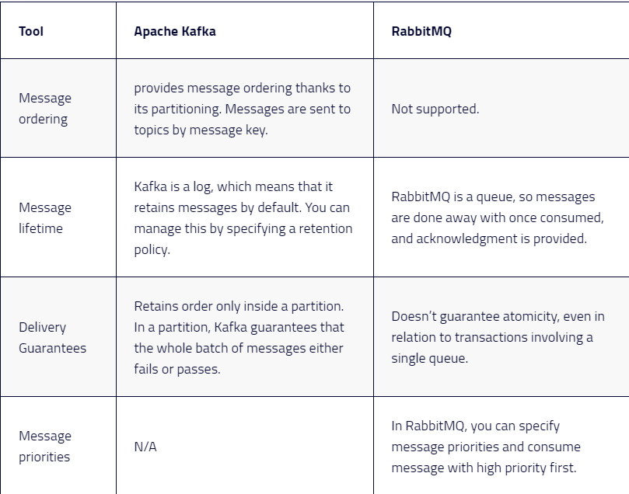
Why Kafka over
Rabbit MQ?

Slide 15
03
Core Concepts of Apache Kafka
Let us understand what we need to know before we start working with Apache Kafka

Slide 16
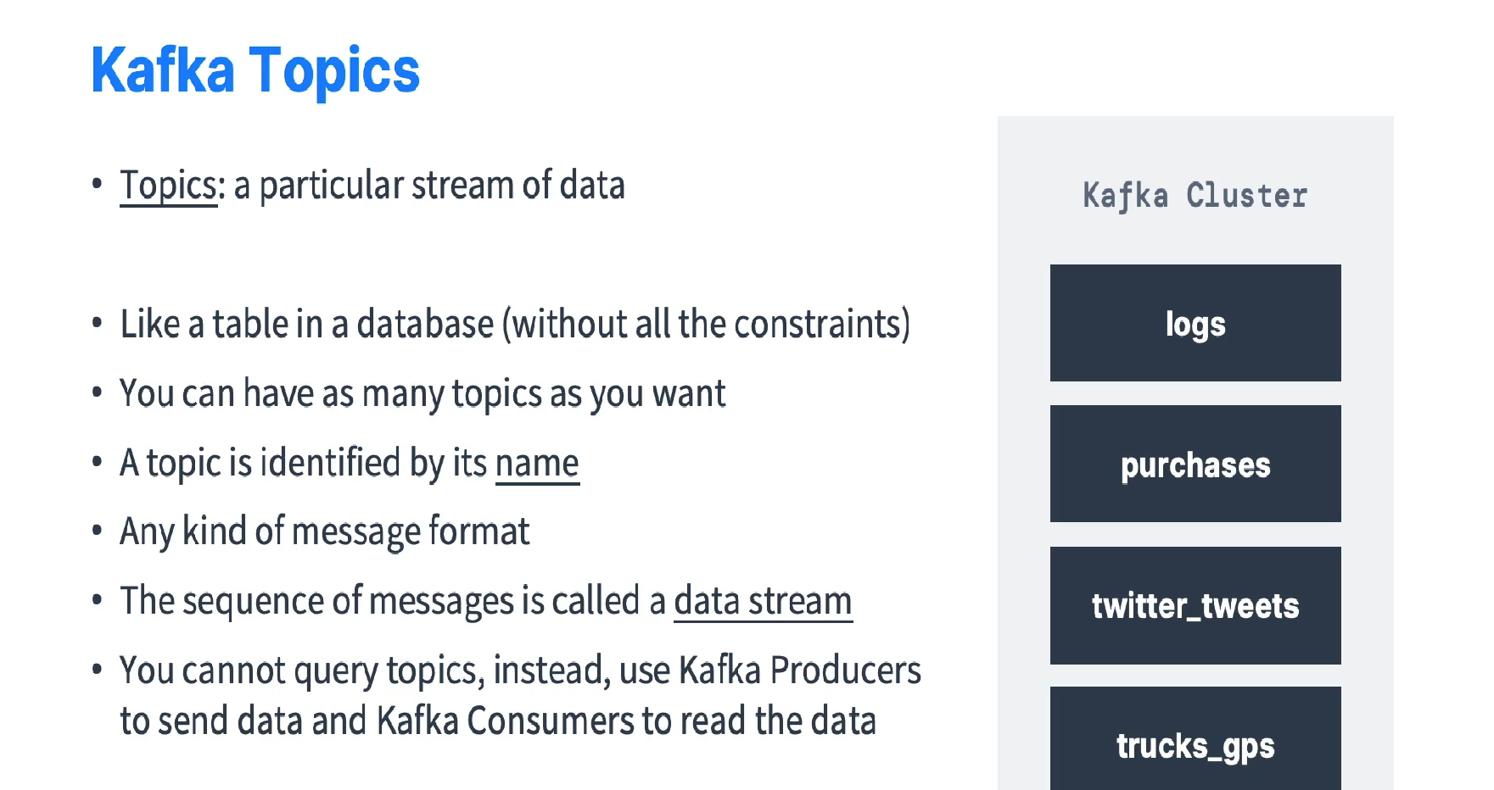

Slide 17
Topics
Data is stored in topics.
Producer A1
Producer A2
Kafka topic
…
new
Older msgs
Newer msgs
0
1
2
3
4
5
Producers always append to “tail”
(think: append to a file)
Broker(s)
Offset(s)

Slide 18
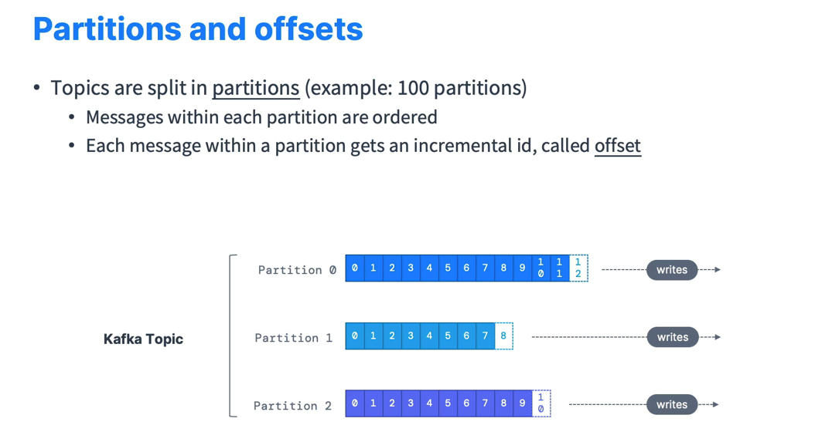

Slide 19
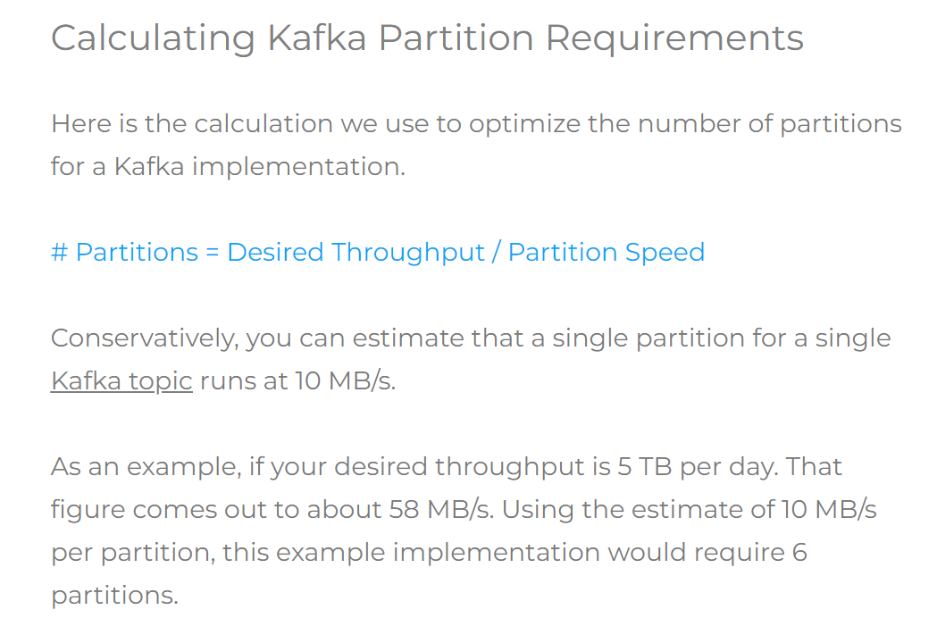

Slide 20
What is Throughput?
When it comes to performance testing throughput, it's about measuring the capacity of a system or network to handle data processing. In simpler terms, throughput is the number of transactions a system can handle in a given time period

Slide 21
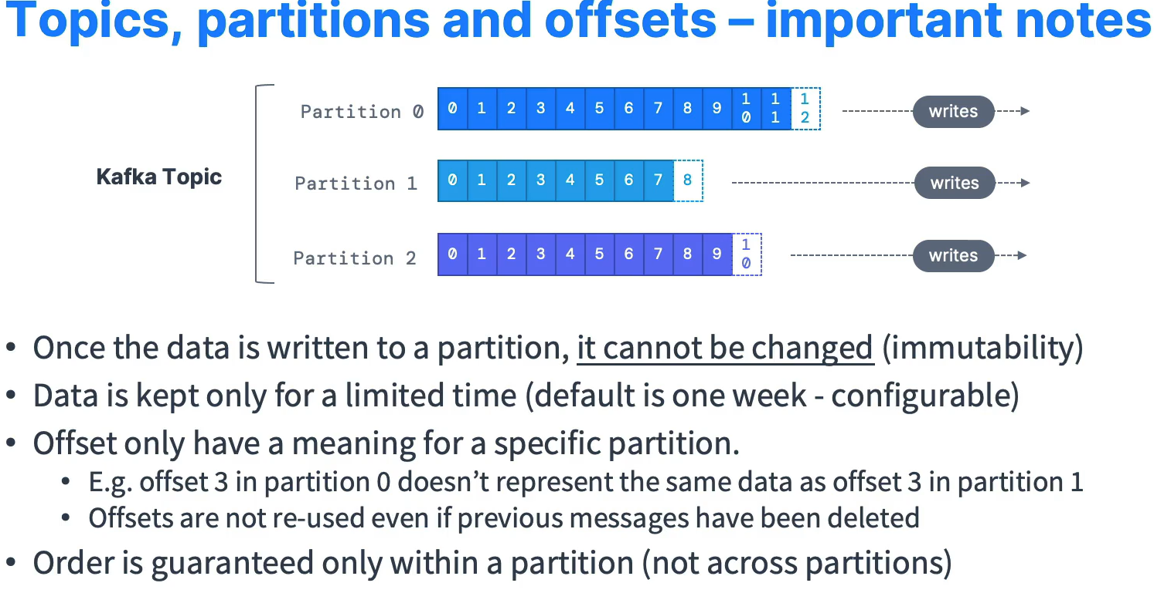

Slide 22
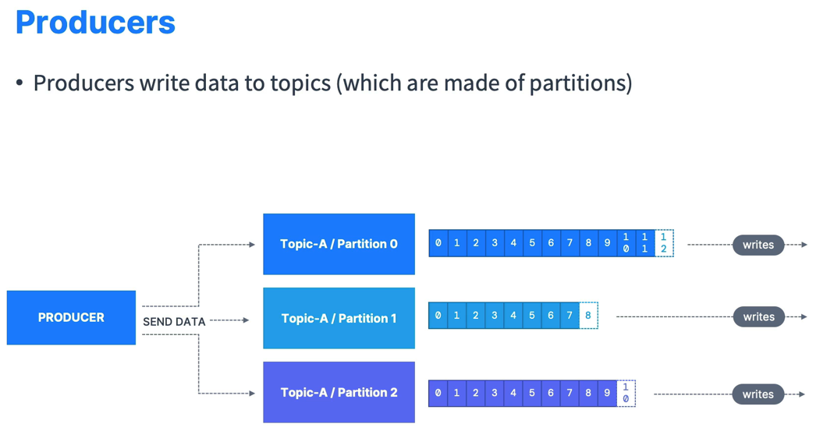

Slide 23
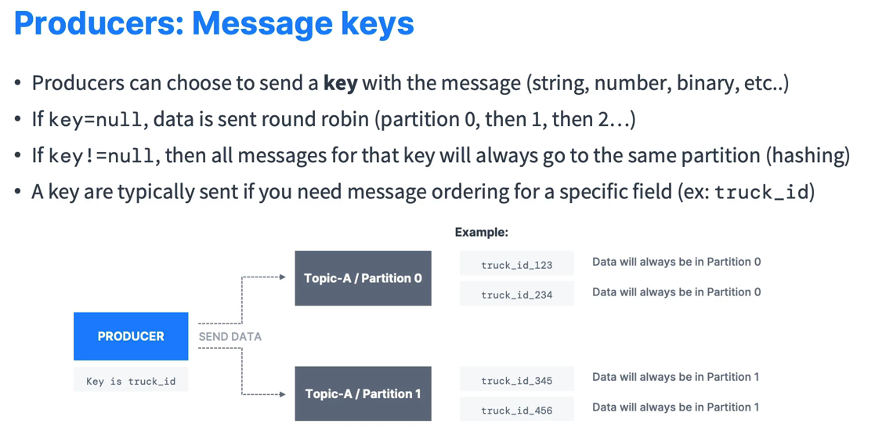

Slide 24
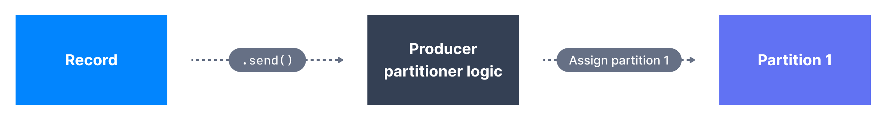
Scenarios with Partition Keys
A partitioner is the process that will determine to which partition a specific message will be assigned to.
A) Partitioner when key!=null
Key Hashing is the process of determining the mapping of a key to a partition In the default Kafka partitioner, the keys are hashed using the murmur2 algorithm
targetPartition = Math.abs(Utils.murmur2(keyBytes)) % (numPartitions - 1)

Slide 25
Scenarios without Partition Keys
When key=null, the producer has a default partitioner that varies:
Round Robin: for Kafka 2.3 and below
Sticky Partitioner: for Kafka 2.4 and above
Sticky Partitioner improves the performance of the producer especially with high throughput.

Slide 26
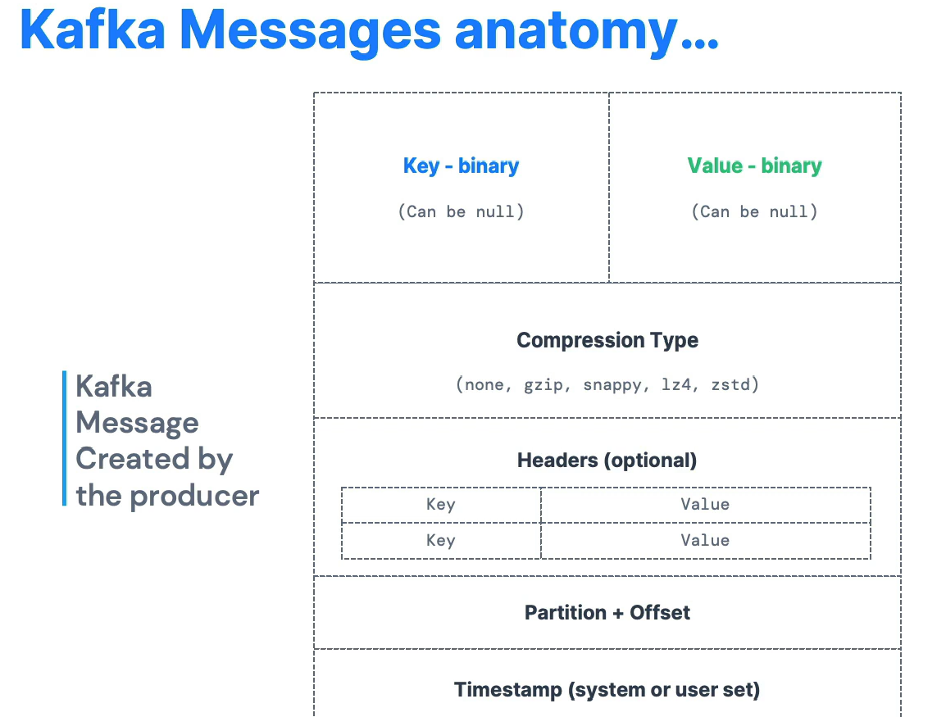

Slide 27
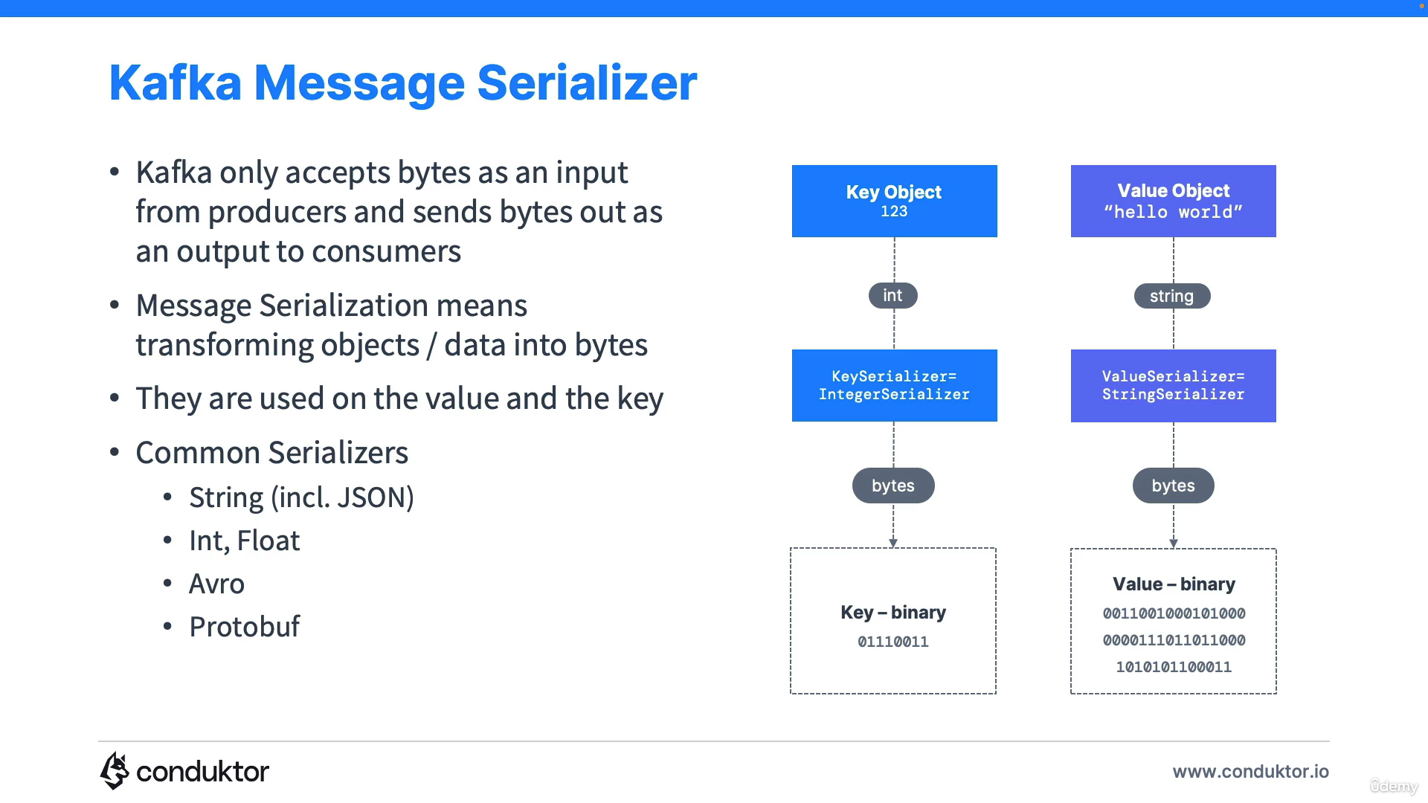

Slide 28
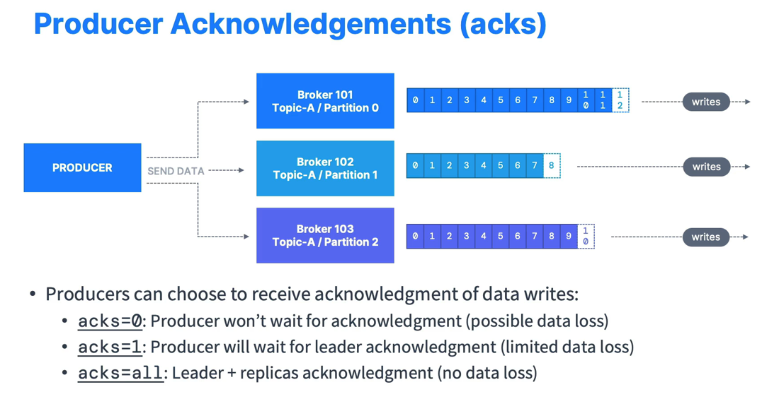

Slide 29
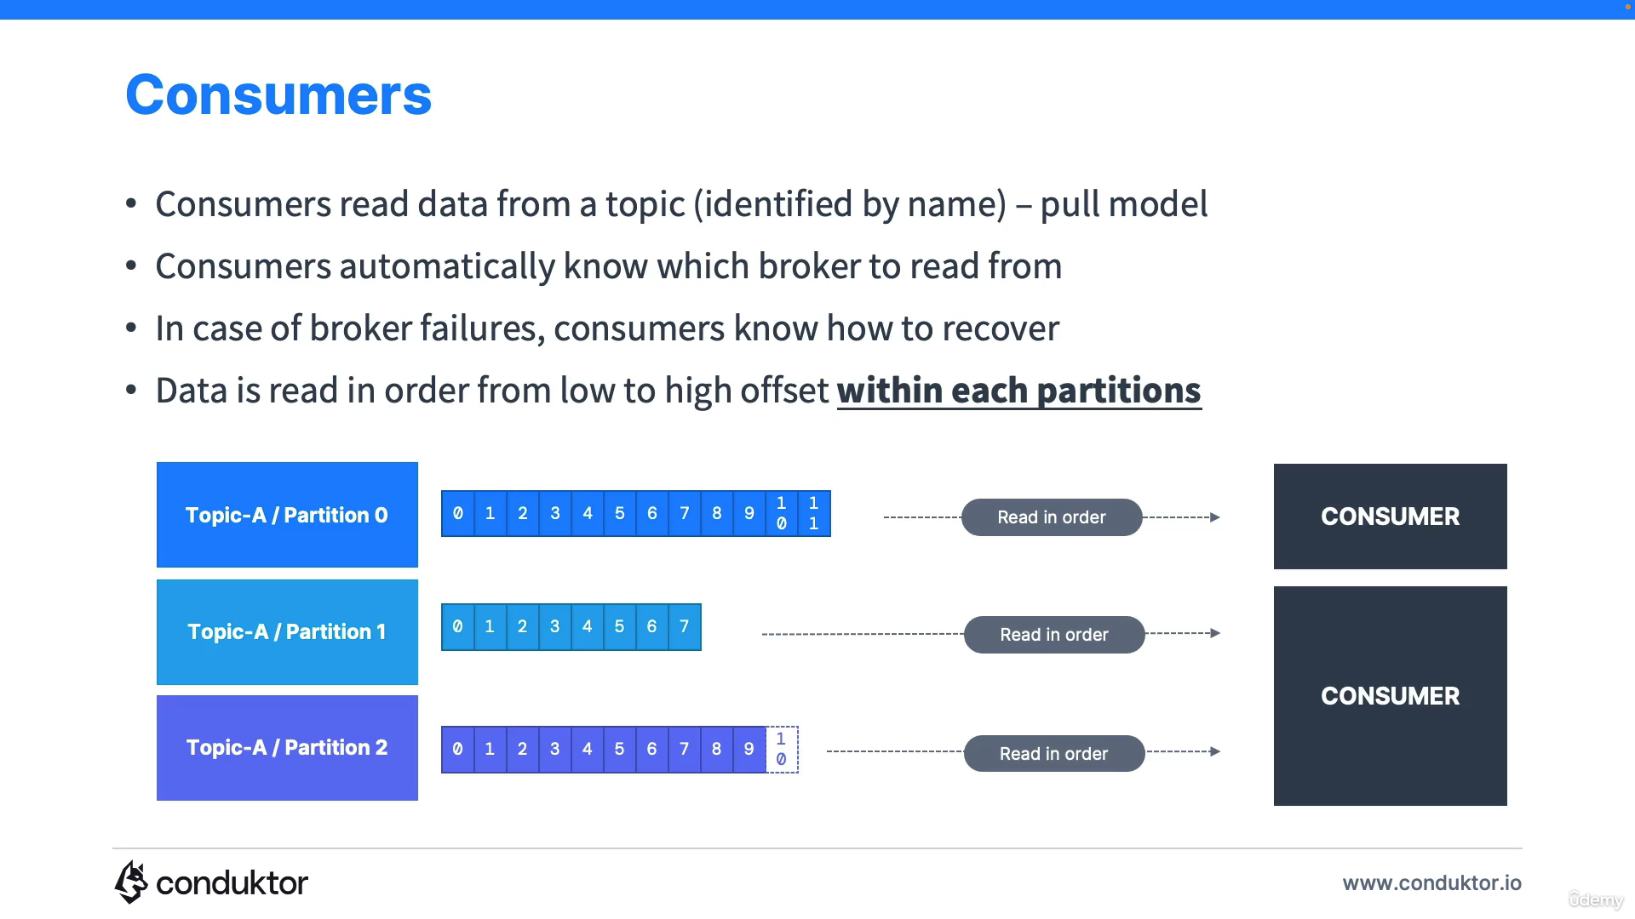

Slide 30
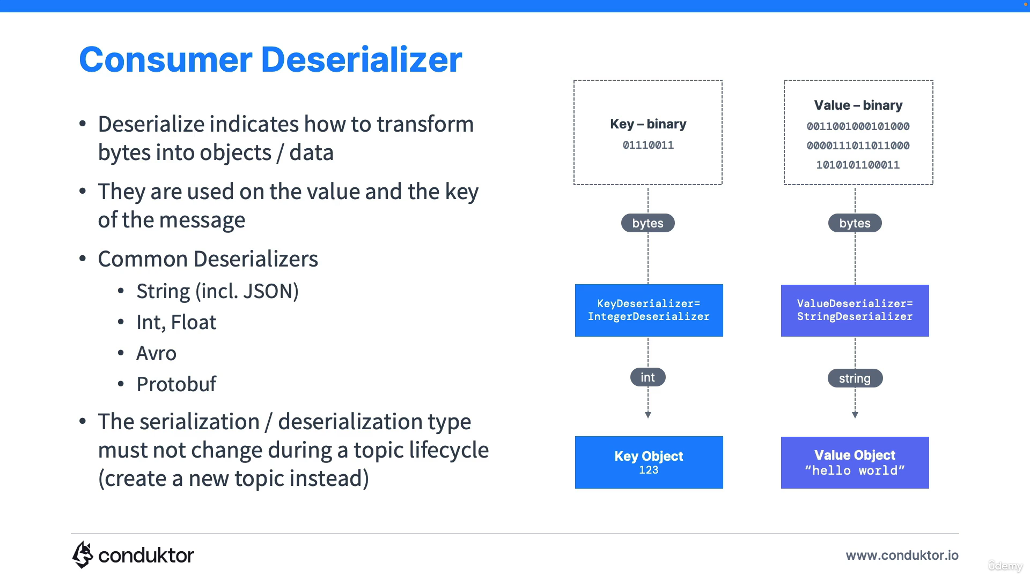

Slide 31
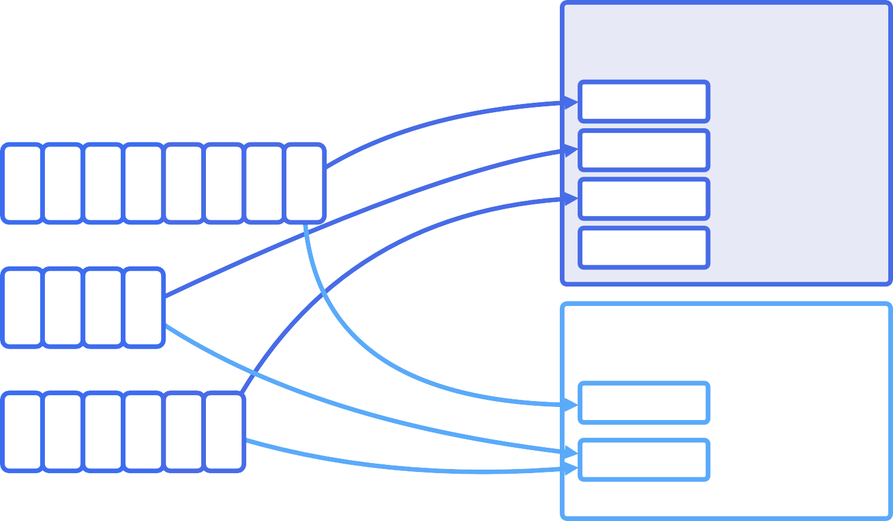
Consumer Groups
CONSUMER GROUP A
TOPIC
CONSUMER
p0, offset 7
CONSUMER
p1, offset 3
PARTITION 0
0 1 2 3 4 5 6 7
CONSUMER
p2, offset 5
CONSUMER
PARTITION 1
0 1 2 3
CONSUMER GROUP B
CONSUMER
p0, offset 7
p1, offset 3
p2, offset 5
PARTITION 2
0 1 2 3 4 5
CONSUMER

Slide 32
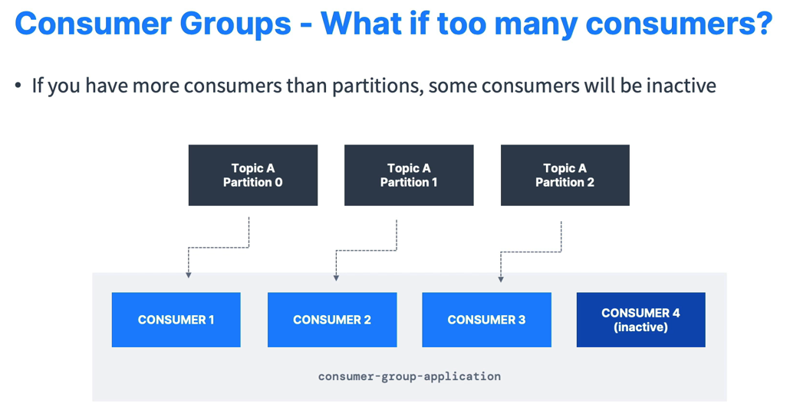

Slide 33
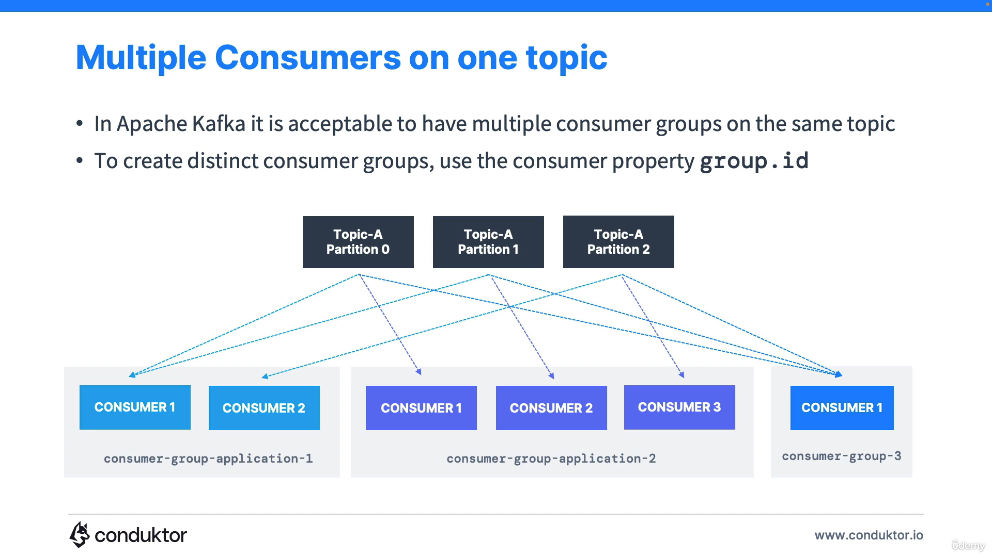
Notes:
Within a consumer group, only one consumer is going to be assigned to one partition.
Why we have multiple consumer groups? Lets say trucks_gps topic, so here location service is one consumer group and notification service is another consumer group.
To create distinct consumer groups, use the consumer property group.id

Slide 34
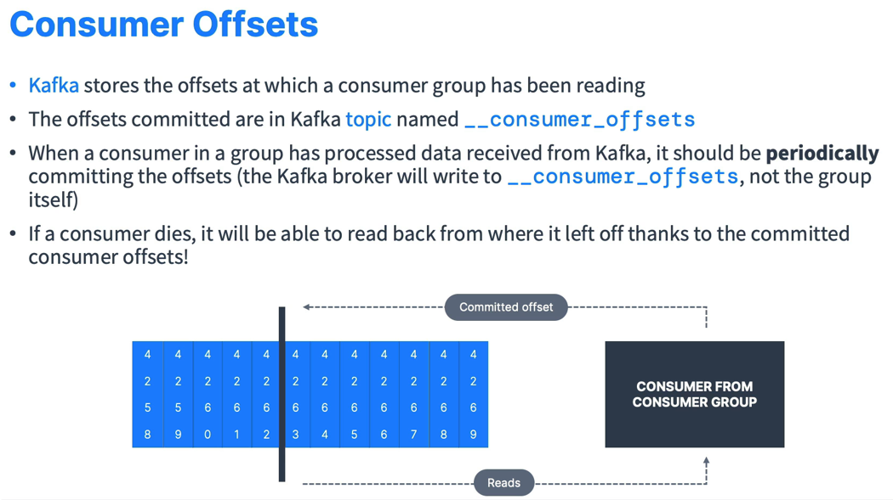

Slide 35
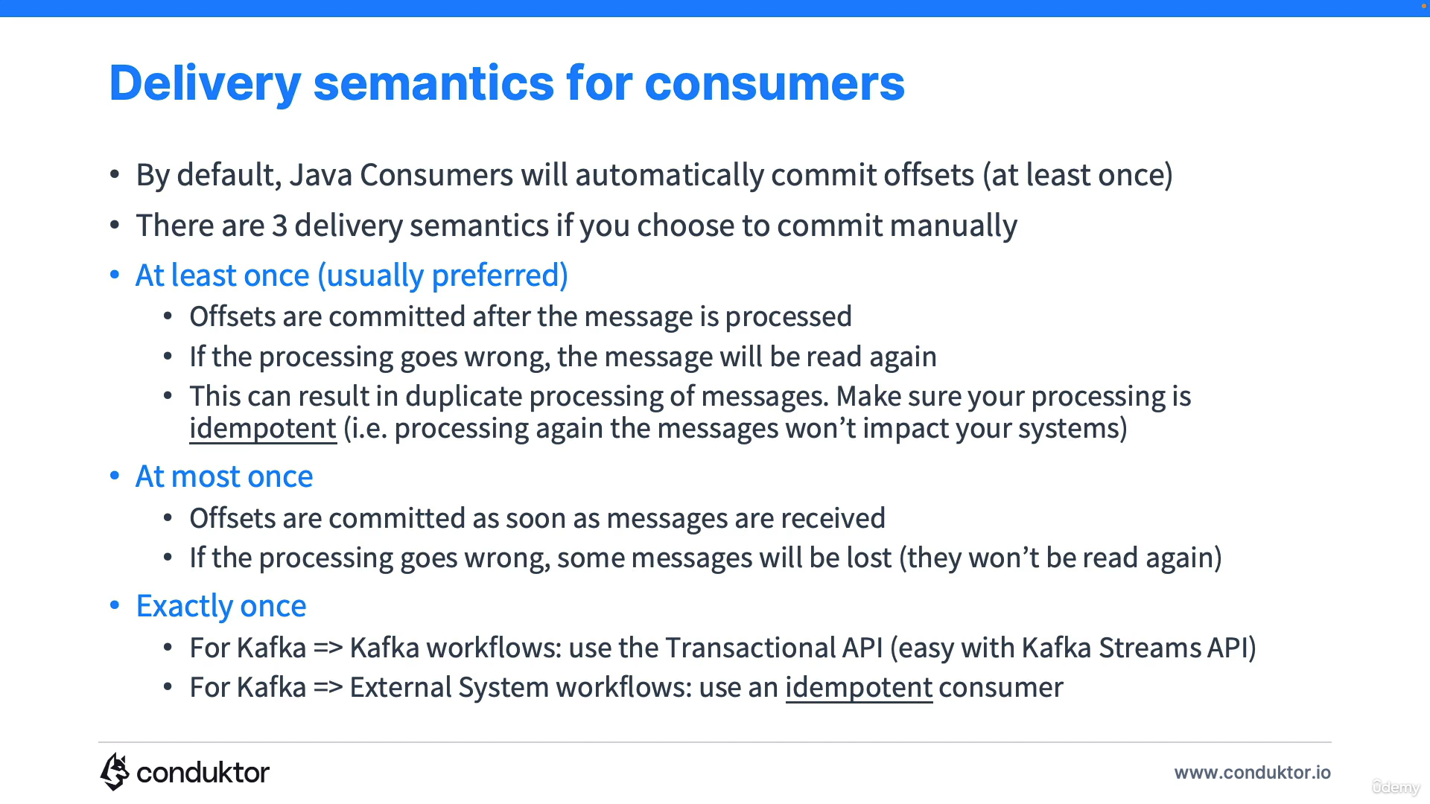

Slide 36
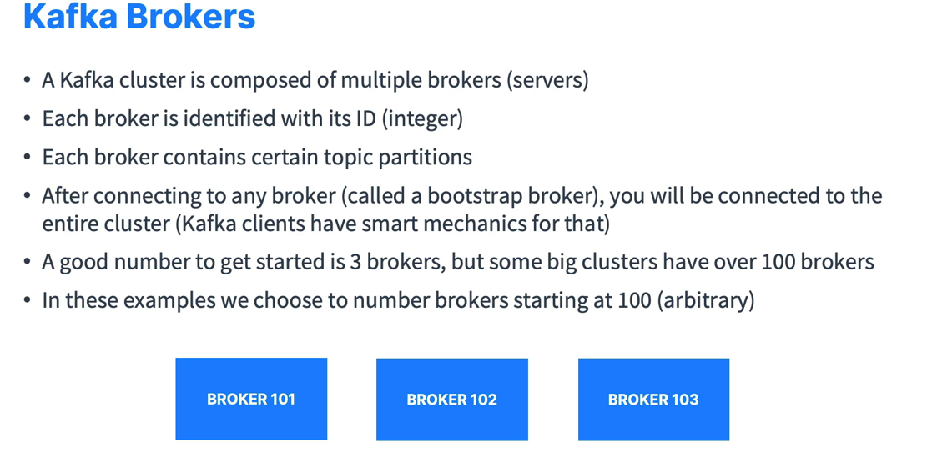

Slide 37
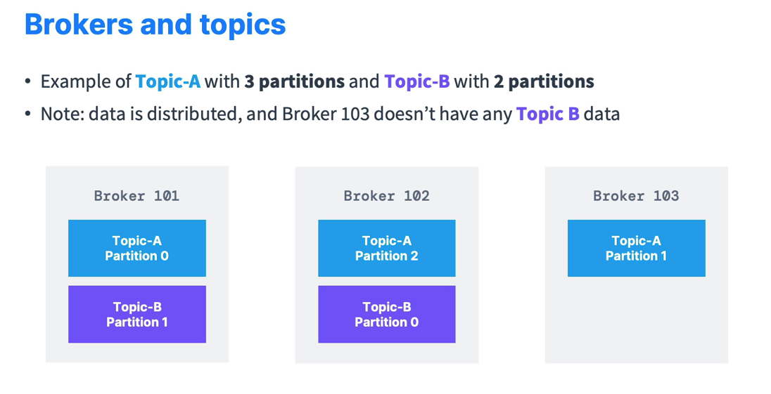

Slide 38
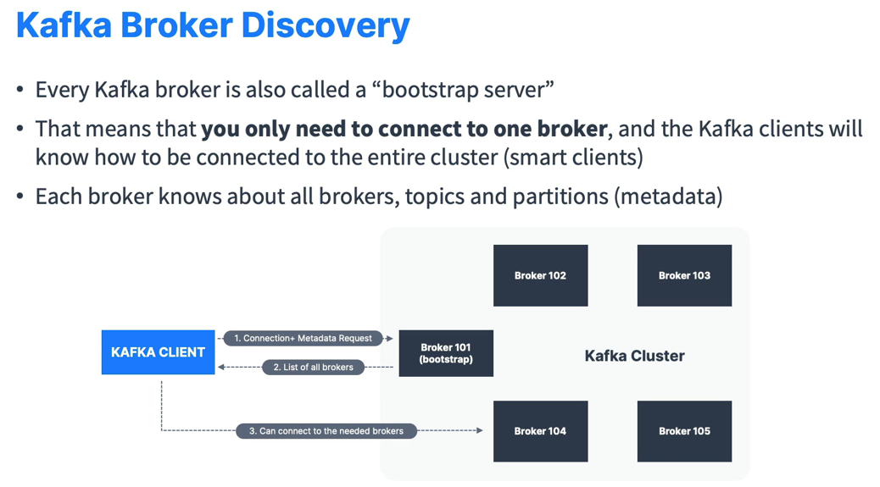

Slide 39
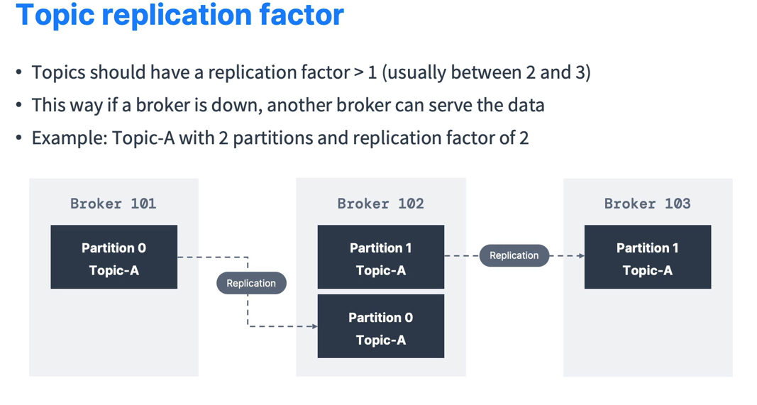

Slide 40
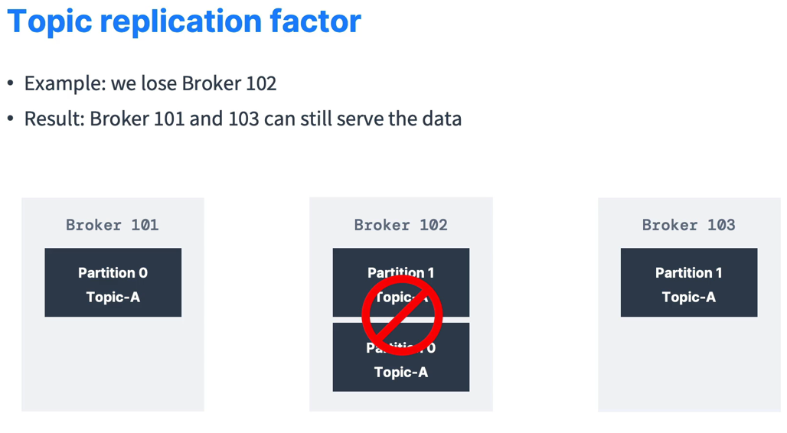

Slide 41
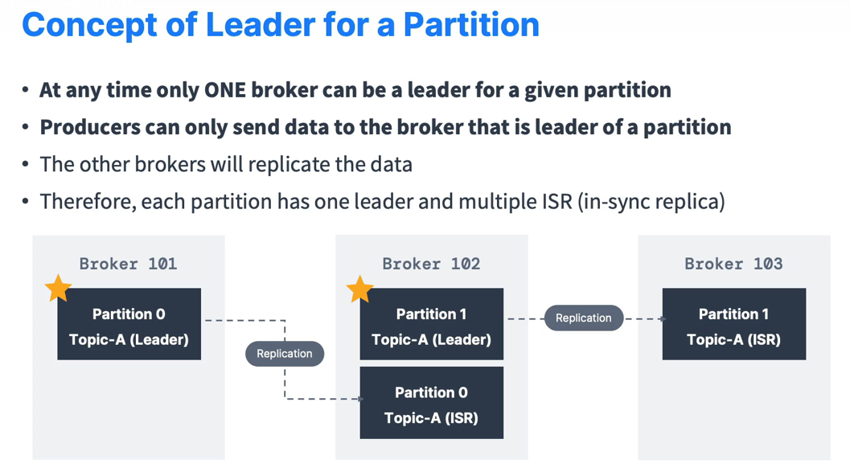

Slide 42
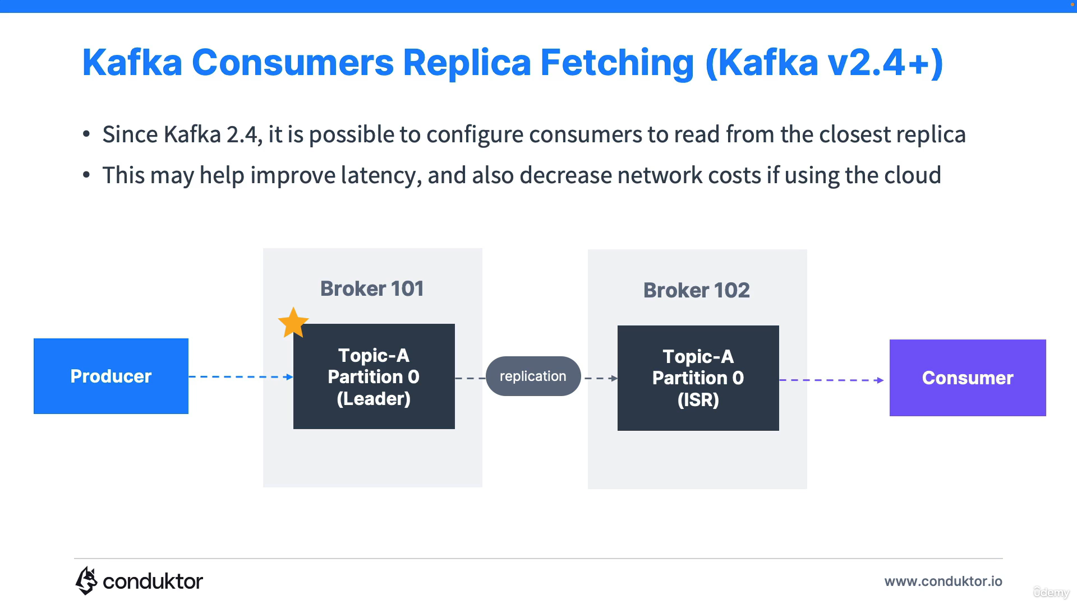

Slide 43
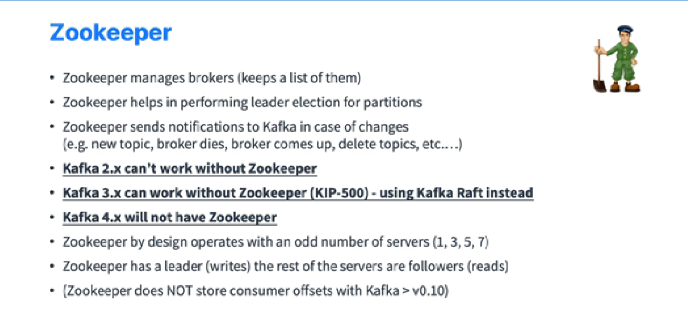
Zookeeper

Slide 44
Zookeeper vs KRaft
Zookeeper adds an extra management layer for Kafka
Kraft makes deployment and operations management much simpler. Imagine if we had to manage just one distributed system instead of two! Moreover, this also improves the scalability due to the more efficient metadata handling
One of the quorum controllers acts as the leader and creates events in the metadata topic within Kafka. The other controllers within the quorum follow the leader controller by responding to these events.
When one of the brokers fails due to partitioning, it can catch up on the missed events from the log upon rejoining. This reduces the unavailability window.
Unlike the Zookeeper-based controller, the quorum controller doesn't need to load the state from Zookeeper.
When the leadership changes, the new active controller already has all the committed metadata records in memory.

Slide 45
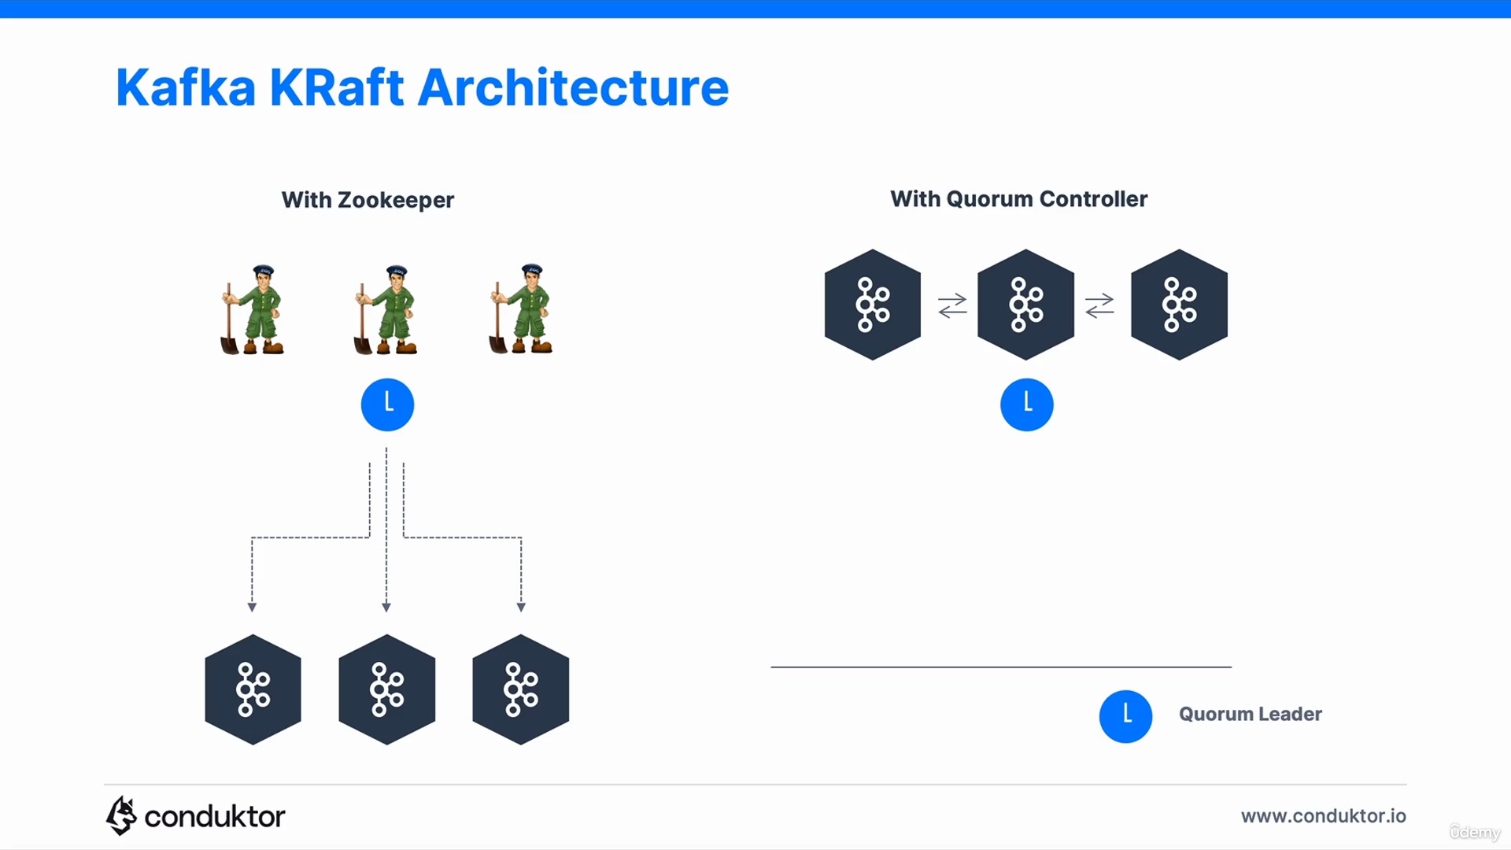

Slide 46
Architecture using Kafka
04
Let us look at the different architectures implemented by Apache Kafka

Slide 47
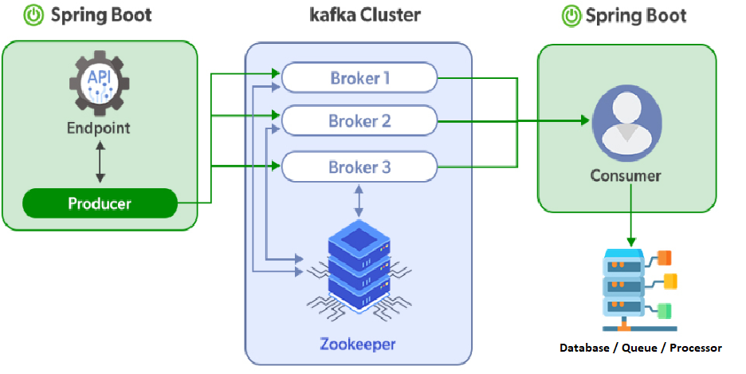
Producer Consumer Model

Slide 48
05
Practical Use Case
Let us now dig into a practical example implementing all the core features we just learnt about in a real time example

Slide 49
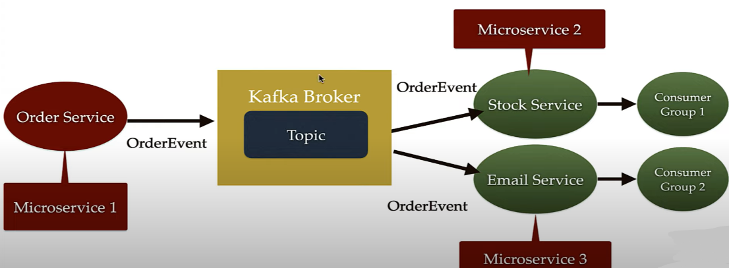

Slide 50
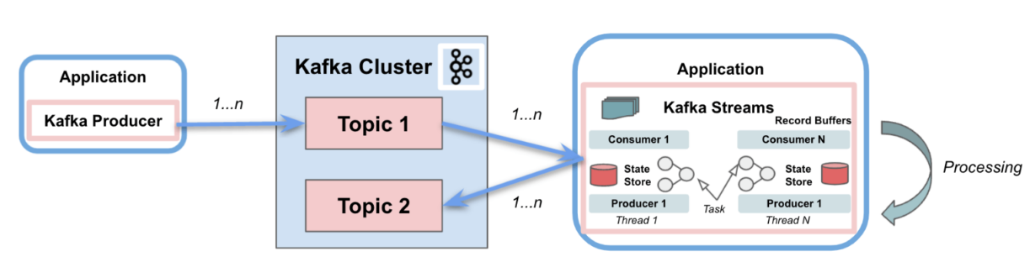
Kafka Streams:

Slide 51
Questions?

Slide 52

Thank you!
Saikiran Kondru
Senior Software Engineer

